Slide 1
Streamlining HR Operations with LLM-based Application

Slide 2
Introduction
Finding the best candidate for a specific job from a recruitment process within the shortest time is a challenge for a company nowadays. Nowadays, there are too many applicants, and it takes too much time and effort to get suitable candidates for a company’s job. The Human Resources team needs more workforce to scrutinize the resumes or CVs of candidates.
The project aims to develop a more flexible, realistic and expert resume ranker system that ranks the resumes effectively and efficiently and gives the best candidate or candidates. This is a simple Django-based resume ranker website where recruiter users post jobs, candidate-users apply for the job, fill in the required data, and upload resumes. The system ranks the resumes based on the document similarity of the job description and the resumes using the KNN model. It saves human efforts, time, and cost.

Slide 3
Overview
The LLM-based application simplifies and improves HR processes by using Language, Logic, and Machine Learning. It leverages Natural Language Processing, machine learning, and analytics to enhance efficiency, effectiveness, and decision-making in HR operations . This user-friendly, scalable, and customizable application integrates with existing HR systems and tools, ensuring smooth data flow and compatibility.

Slide 4
Motivation
Optimize HR Processes
Minimize Manual Efforts
Enhance Decision-making
Improve The Employee Experience
Simplify the Process

Slide 5
Description
Input Resume From Student / Applicant :
Accept resumes in different formats.
Input Job Description From Company :
Evaluate the Keywords Based on JD.
OR
Take JD input in standard format ( using a simple form like google forms )
CV Ranking: ( Round 1 )
Rank CVs based on how well they match the job requirements.
Shortlist candidates based on ranking
Email Notifications:
Send emails to shortlisted candidates, explaining the next steps in the hiring process.

Slide 6
Screening Questions: ( Round 2 )
Create Simple Basic Introduction questions for each candidate .
7 . Communication:
Stay in touch with the HR team.

Slide 7
Candidates
Upload Resume
Shortlisted CV’s
Database for saving 1) candidate info
2) Candidate Resume
3) Company JD
Resume Ranking Algorithm Based on JD
Send Mail To Shortlisted CV’s
Admin / Company Login
Upload JD OR fill JD Form
Flowchart

Slide 8
Technology
Backend – Python
Front End – HTML , CSS , JavaScript
Database – MySQL with Django

Slide 9
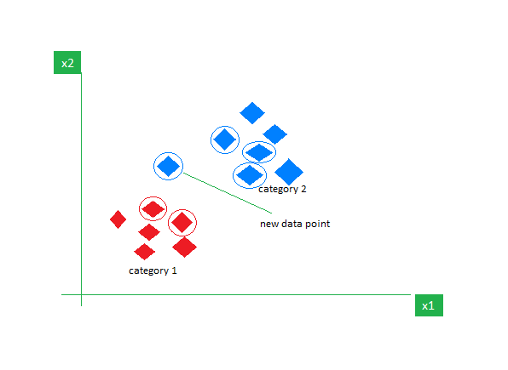
Algorithm Used - KNN
K-Nearest Neighbor (KNN) algorithm is a distance based supervised learning algorithm that is used for solving classification problems. In this, we will be looking at the classes of the k nearest neighbors to a new point and assign it the class to which the majority of k neighbors belong too.
To identify the nearest neighbors we use various techniques of measuring distance, the most common of them being the ‘Euclidean Distance’.

Slide 10
What Packages Need To Use
Python 3.9.7 or higher
Django 4.0 or higher
pip 22.3.1 or higher

Slide 11
Concepts that we will use
TF-IDF: It calculates a score for each keyword that signifies its importance to the document or resumes.
Data Preprocessing: Data cleaning, word stemming, and verb lemmatization etc.
TF(‘keyword’) = number of appeared (‘keyword’)/Total number of (‘keyword’)
IDF(‘keyword’) = log(total number of resumes / total number of the resume with term ‘keywords’)
It sets IDF log value = 1 for the required resume and 0 for the unwanted.
Generate Document Similarity Score: Using the KNN (K-Nearest Neighbor) model and the TF-IDF weight of the resumes, the system generates a document similarity score (KNN-score) of each resumes according to the job description. Ranking: Based on the KNN-scores, the system ranks the resumes and shortlists them.

Slide 12
Literature Survey
Comparative performance analysis of K-nearest neighbour (KNN) algorithm and its different variants for disease prediction – 2022
A Review on Analysis of K-Nearest Neighbor Classification Machine Learning Algorithms based on Supervised Learning – 2022
A Survey of kNN Algorithm - 2018

Slide 13
Real World Applications
Colleage Recruitment Process
Consultancy Services
Various Company’s
Government Organizations
Private Organizations

Slide 14
Advantages
Efficiency
Accuracy
Simplicity
Time saving
Scalability
Cost Effectiveness

Slide 15
Challenges Involved
Complications Due to Various Resume Formats
Maintaining Database / Server
Security Issues

Slide 16
Conclusions
Our system aims to streamline the recruitment process by assessing and ranking resumes based on job requirements. This will simplify the task for recruiters, making it easier for them to shortlist candidates. While there are several existing systems in the market, only a few of them focus on ranking resumes in a targeted and specific manner.

